Slide 1
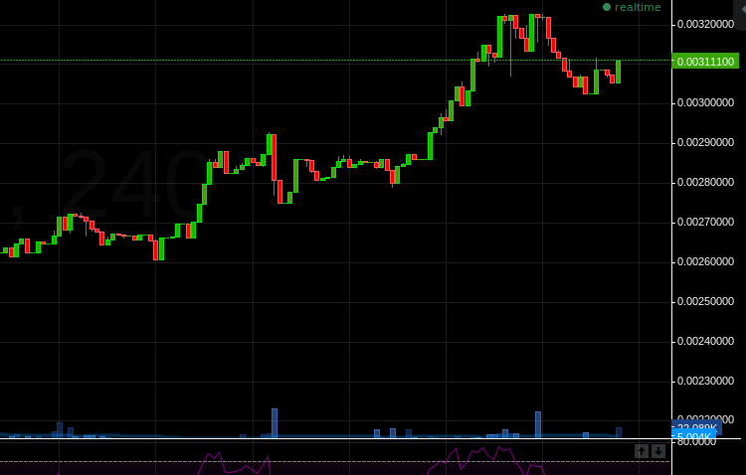








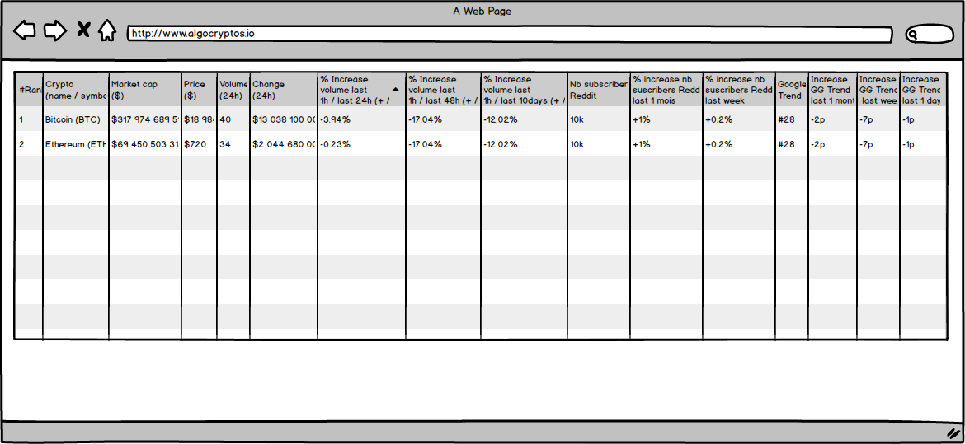




INTERNET
Github
Reddit
CryptoCompare
CoinMarketCap
REST / JSON
DB
5
DataImporter
AlgoKPI
DB
Fronting Web
APINode

